Slide 1
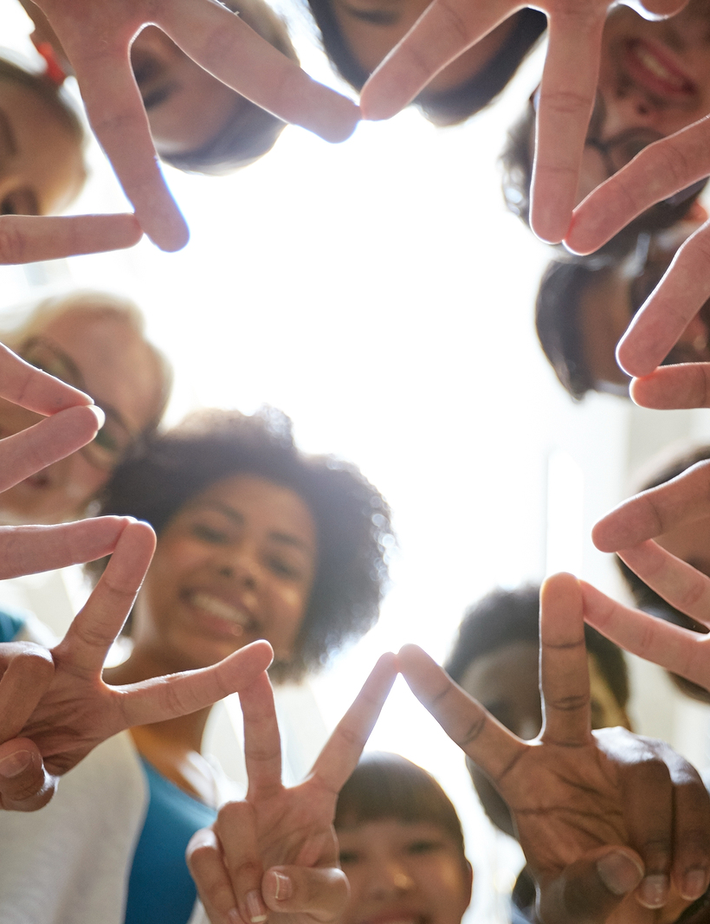
Kindness toward Others

Slide 2
Small Group Discussion Questions: Note: Do not use names of others to protect privacy.
A lot of people say that teenagers are self-absorbed and don't care about anything but themselves. Do you agree or disagree? Support your position with examples.
When you are with a group of peers, what things might other people do or say that make you feel good? What things make you feel bad? Can you give any real-life examples or personal experiences?
How do you feel when people show that they really care about you? How do you feel when you do something really caring for someone else? Can you give any real-life examples or personal experiences?
Can you choose to be a caring person, or do you have to be born that
way? Support your position with examples.
Notes:
Divide the class into 4 groups. Give each of the groups a different question. Have each group discuss the assigned question within their group. Have each group then share their response to the class. Allow for other groups to respond and comment.
- The objective is to get students thinking about how they receive kindness so they can think about how they could give it in return, to get them thinking that kindness is a choice and it may not always be the popular or easy thing but it makes a difference,

Slide 3
MAKE A DIFFERENCE…
One person at a time…

Slide 4
This Grandma Waved to These Students Every Day—When She Wasn’t There, They Had to Find Her
By Kelsey Straeter Resource link

Slide 5
93-year-old Louise Edlen has been waving to this school bus full of lively children for the last 5 years from her little dining room window.
She doesn’t know their names, but she knows their faces. Each morning she waits for their smiles, and she eagerly anticipates their waves back in her direction.
They also don’t know Louise, but according to these students, she’s “part of the family.”

Slide 6
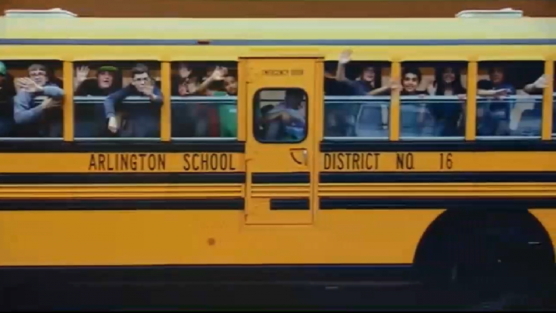
The morning wave has truly become the Arlington school bus No.7’s tradition, so much so, that the kids panicked when they drove by one morning and didn’t see “grandma in the window.”
The bus driver, Carol Mitzelfeld, discovered that Louise had a stroke, and she passed the tragic news onto her students who were seriously worried about their window-waving friend.
One 7th grader, Axtin Bandewerfhorst, told KING 5 News, “Carol was telling us that a lot of times she doesn’t remember her daughter’s name, but she always remembers to wave to the kids on the bus. That made me feel really special.”

Slide 7
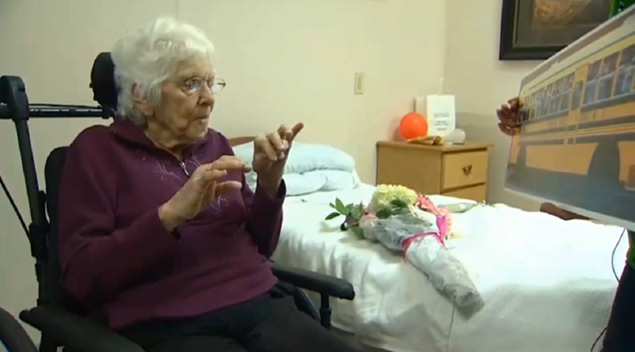
Along with the help of Carol, the students decided to surprise Louise in the hospital with flowers.

Slide 8
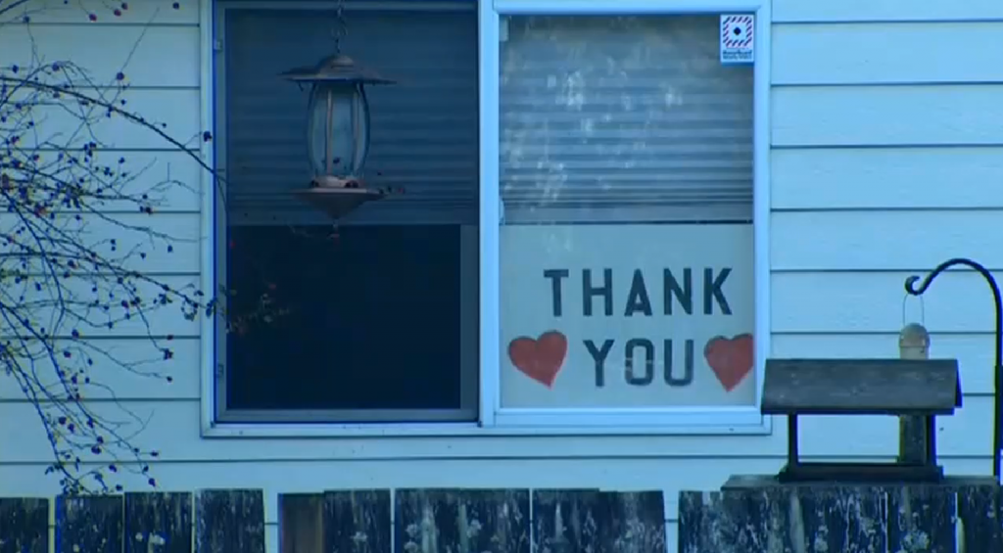
Louise was overwhelmed with the heartwarming gesture from the kids she barely knew.
Because she couldn’t be there to greet them the next morning, she put up this sign instead.
“That made me really smile,” said 10th grader, Cheyanne Holt. “It shows how much we mean to her.”

Slide 9
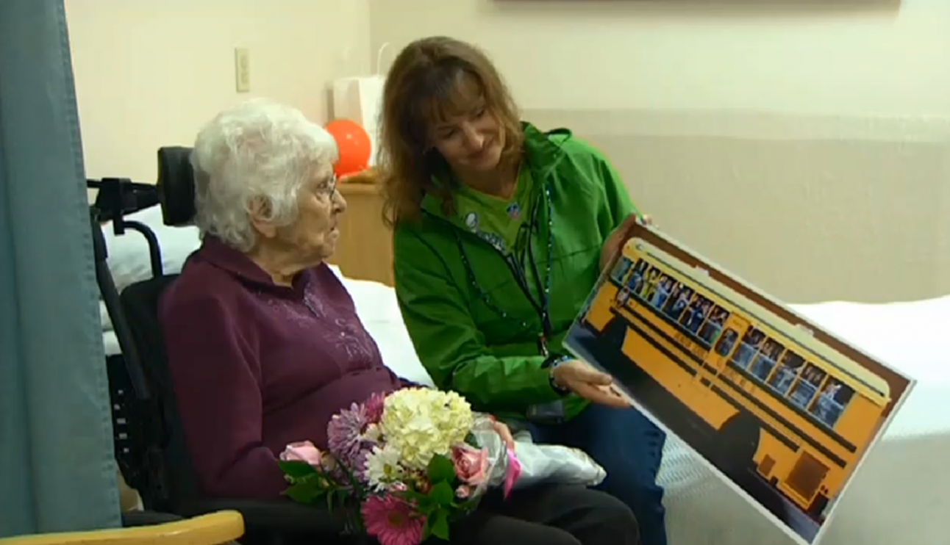
So in response, they made this panorama picture of the bus showing them waving to Louise. They decided to bring the bus to her, since she couldn’t come to them.
“This is from the kids. They miss you and want you to get better,” Carol told Louise.

Slide 10
Since the stroke, it’s been very difficult for Louise to talk, but she did manage to respond: “I miss, them too. I’m trying to get better.”
Her husband Dave said seeing the kids on the bus “is everything in the world to her.”
The story of Louise reminds us to never underestimate just how big the little things can really be. The smiles. The waves. The pats on the shoulder. The simple gestures.
You don’t always have to talk to have a soul connection.
These kids and the “grandma in the window” shared a bond that a thousand words couldn’t do justice.
And it all started with one little wave…

Slide 11
Kindness Challenge
Kindness: Doing favors and good deeds for others; helping others; taking care of others
Titans love, respect, and protect one another.
How will you make a difference? - “One person at a time!”
Hug a friend.
Write thank you notes.
Give up your seat to someone.
Sign up to volunteer.
Give a genuine compliment.
Talk to someone you normally do not talk to.
Make a donation.
Pick up litter.
Write a letter to someone who has made a difference in your life.
Be kind to someone you dislike.
Forgive someone.
Give someone a treat.
Do something unexpectedly nice for someone – Random Act of Kindness
Other ideas?

Slide 12
Kindness Challenge
Write down 3 things YOU can to do during the week to spread a little kindness.

Slide 13
MAKE A DIFFERENCE…
One person at a time…

